Slide 1
Web Frameworks Lecture 6
Web Communication
Verbs
Response Codes
API
Node as a Server

Slide 2
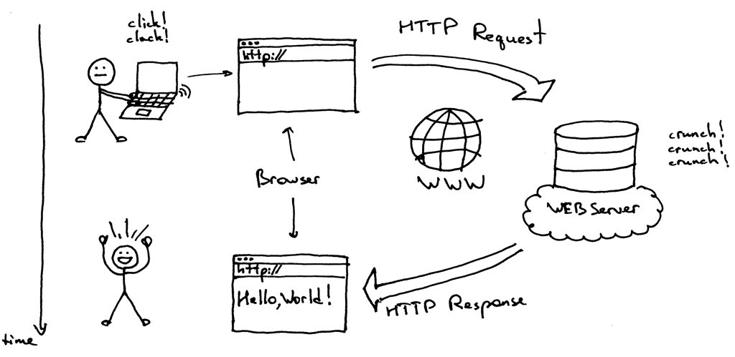
Web Communication

Slide 3
Web Communication
HTTP (Hyper Text Transfer Protocol)
Set of rules that govern web communication
Stateless: Each request is independent from one another. Each request starts out as a new request
State can be maintained client (and server side) via Sessions and Cookies
Http Methods
[GET] Read only request to the server
[POST] Create request
[PUT] Replace request
[DELETE] request to delete something
[PATCH] Update in place

Slide 4
Web Communication
Http Status Codes
1xx – Informational
2xx – Success
3xx – Redirects
4xx – Client Errors
418 I’m a tea pot https://www.rfc-editor.org/rfc/rfc2324#section-2.3.2
5xx – Server Errors
Http Headers
Headers contain additional information sent to / from the server
IE: Type of Request, Type of File, Authentication Information etc

Slide 5
Web Communication
Request
Request URL: Path to be fetched
Http Method
Remote Address (ip address) and Port
Http Version
Optional Headers
Body (Payload)
Response
Http Version
Headers (response)
Status Message (response code)
Access Control
Body

Slide 6
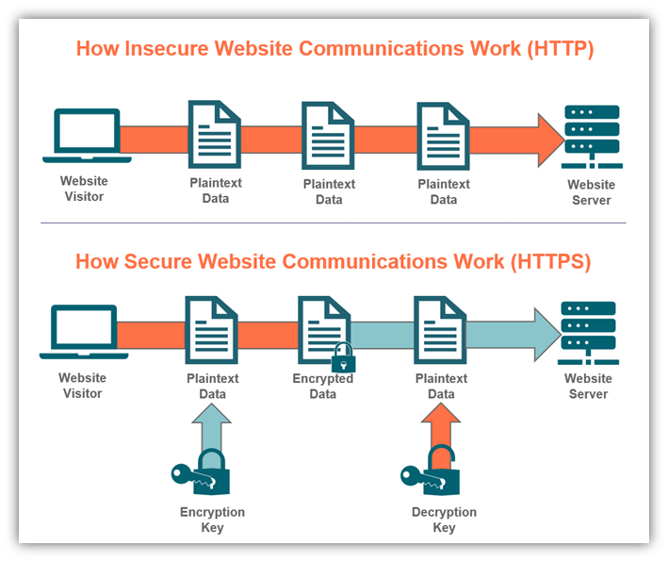
Web Communication
Http vs Https
Https is a secure connection between the client and the server. NOBODY not even your ISP can see the content of site you visit when HTTPS is used.

Slide 7
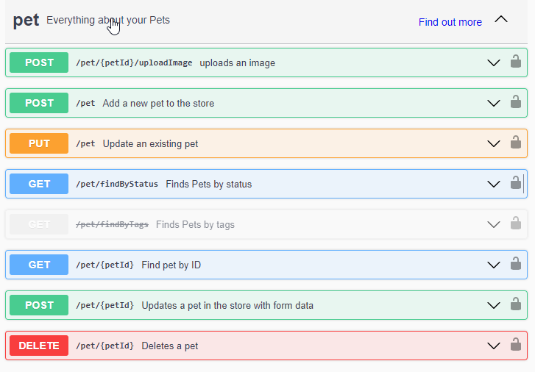
Web Communication
API
Application Programming Interface
It’s a contract like (OOP Interfaces) that lets you know what inputs and outputs and which end points are available on a given web server.
REST (Representational State Transfer) is the most common paradigm used to expose APIs from a server to the corresponding client (s) https://petstore.swagger.io/

Slide 8
Node
FS Module
File Manipulation Library https://nodejs.dev/en/learn/the-nodejs-fs-module/
Path Module
Library for working with Paths and Directories https://nodejs.dev/en/learn/the-nodejs-path-module/
OS Module
Library to retrieve information on the Operating System https://nodejs.dev/en/learn/the-nodejs-os-module/
Http Module
Core to Node networking and communication https://nodejs.dev/en/learn/the-nodejs-http-module/

